Slide 1
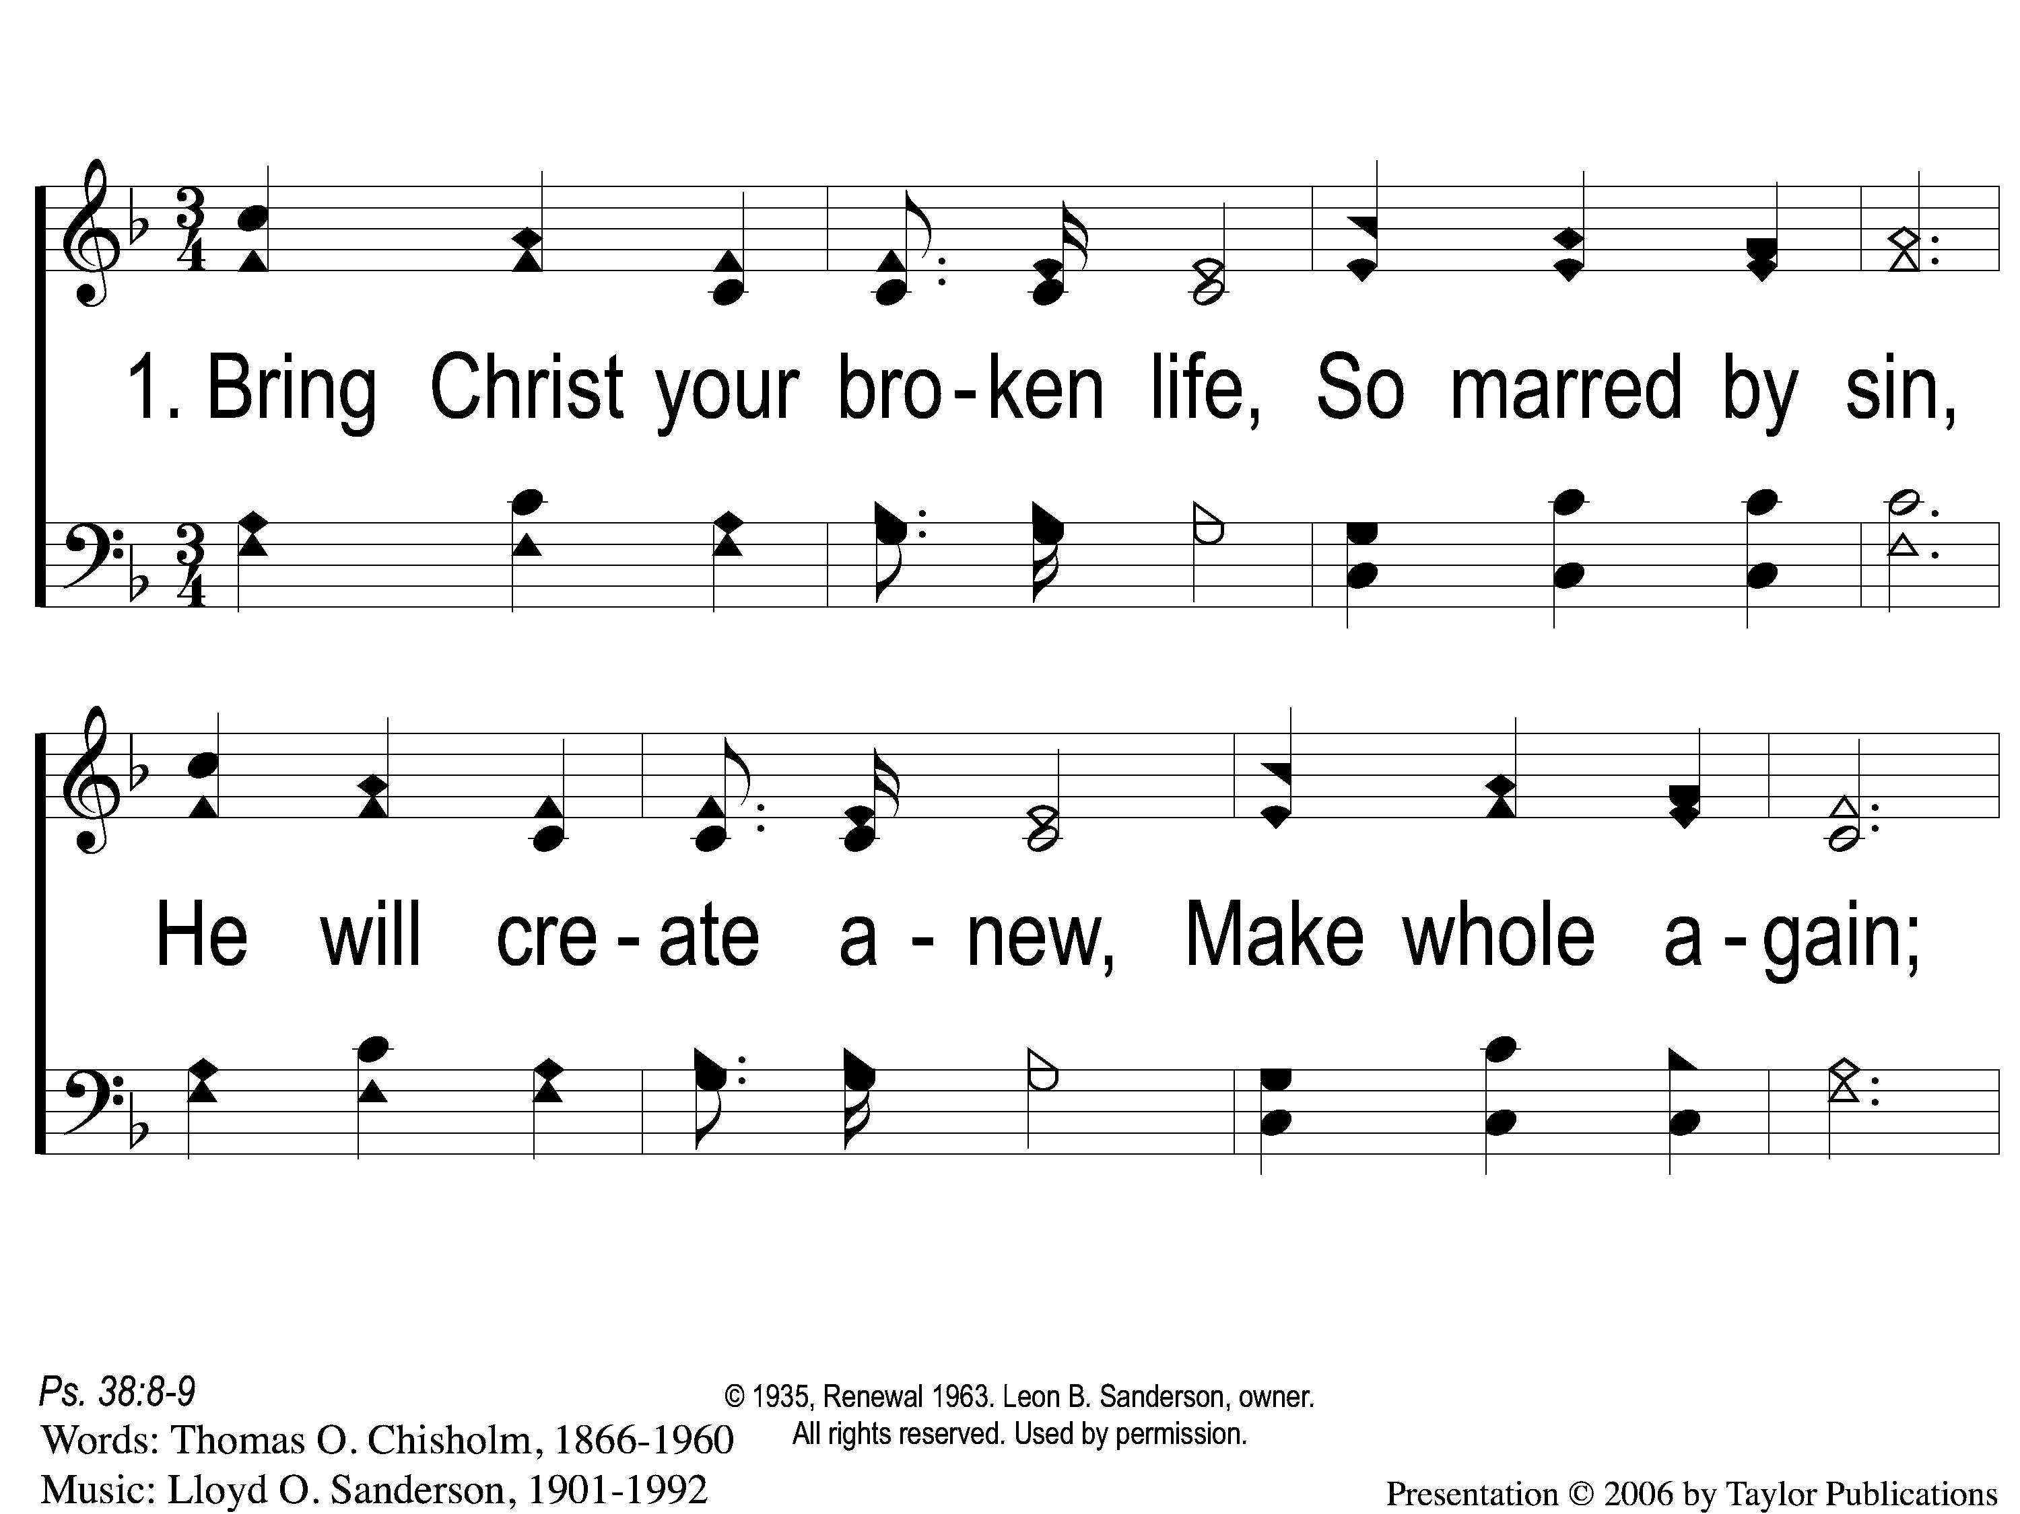
1-1 Bring Christ Your Broken Life
Bring Christ Your Broken Life
62

Slide 2
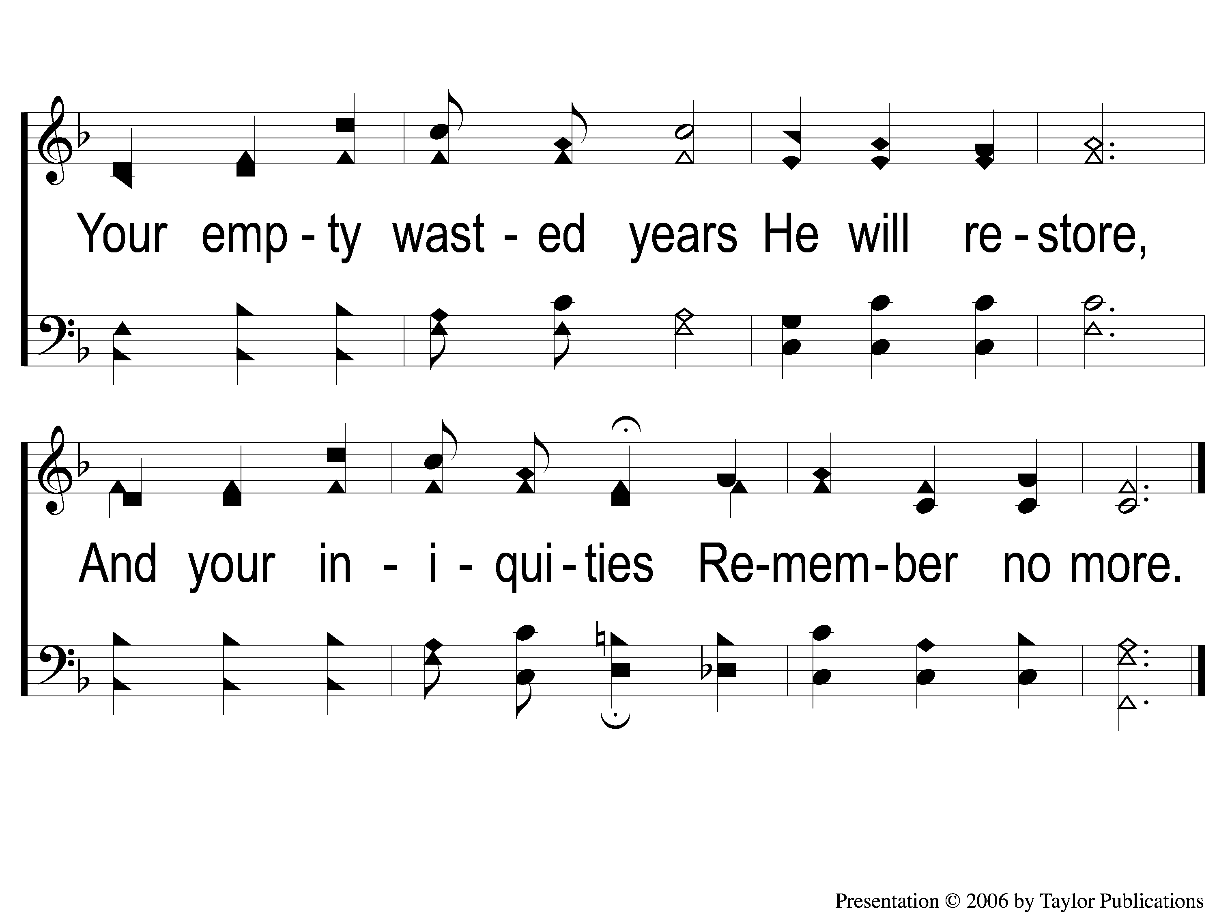
1-2 Bring Christ Your Broken Life
Bring Christ Your Broken Life
62

Slide 3
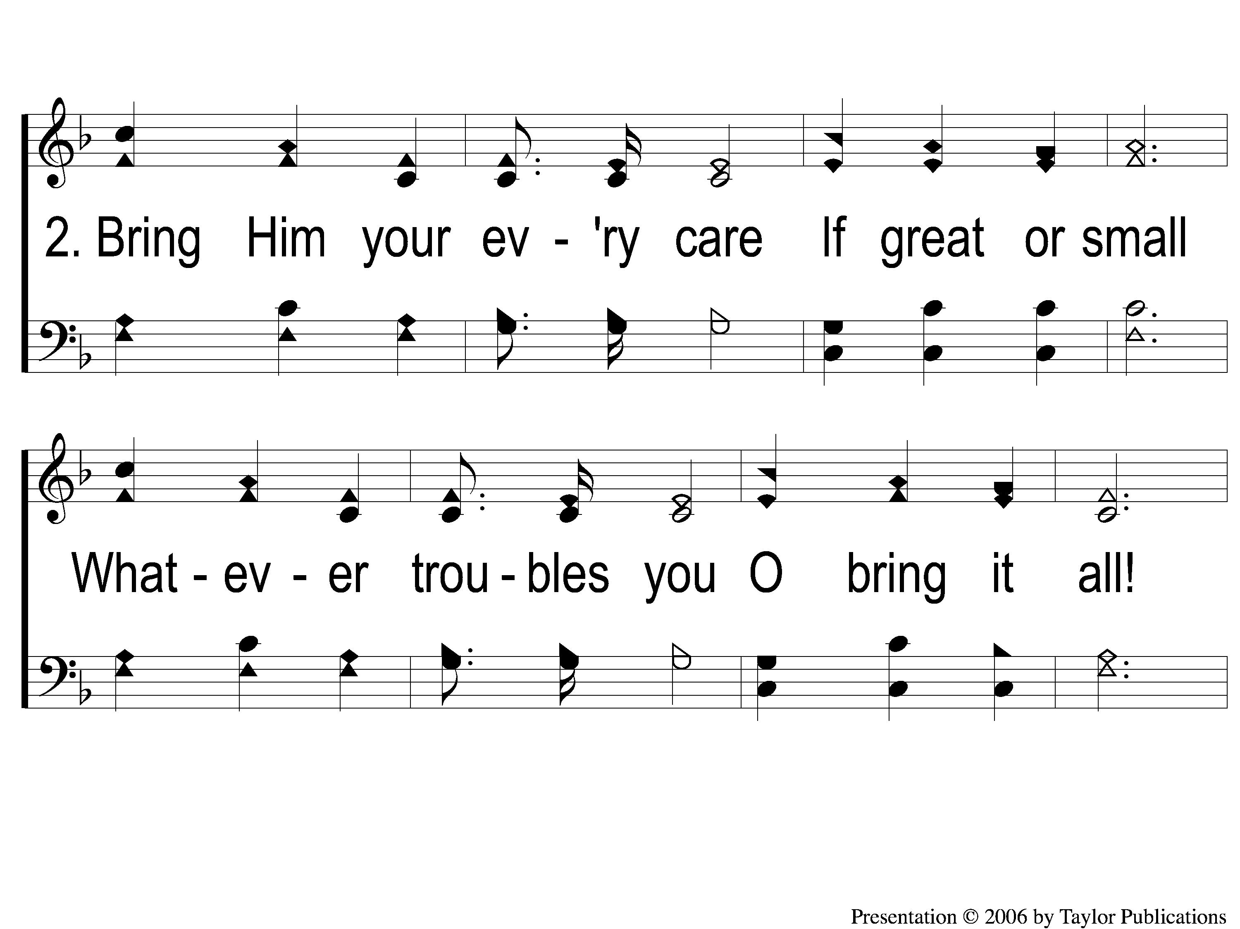
2-1 Bring Christ Your Broken Life
Bring Christ Your Broken Life
62

Slide 4
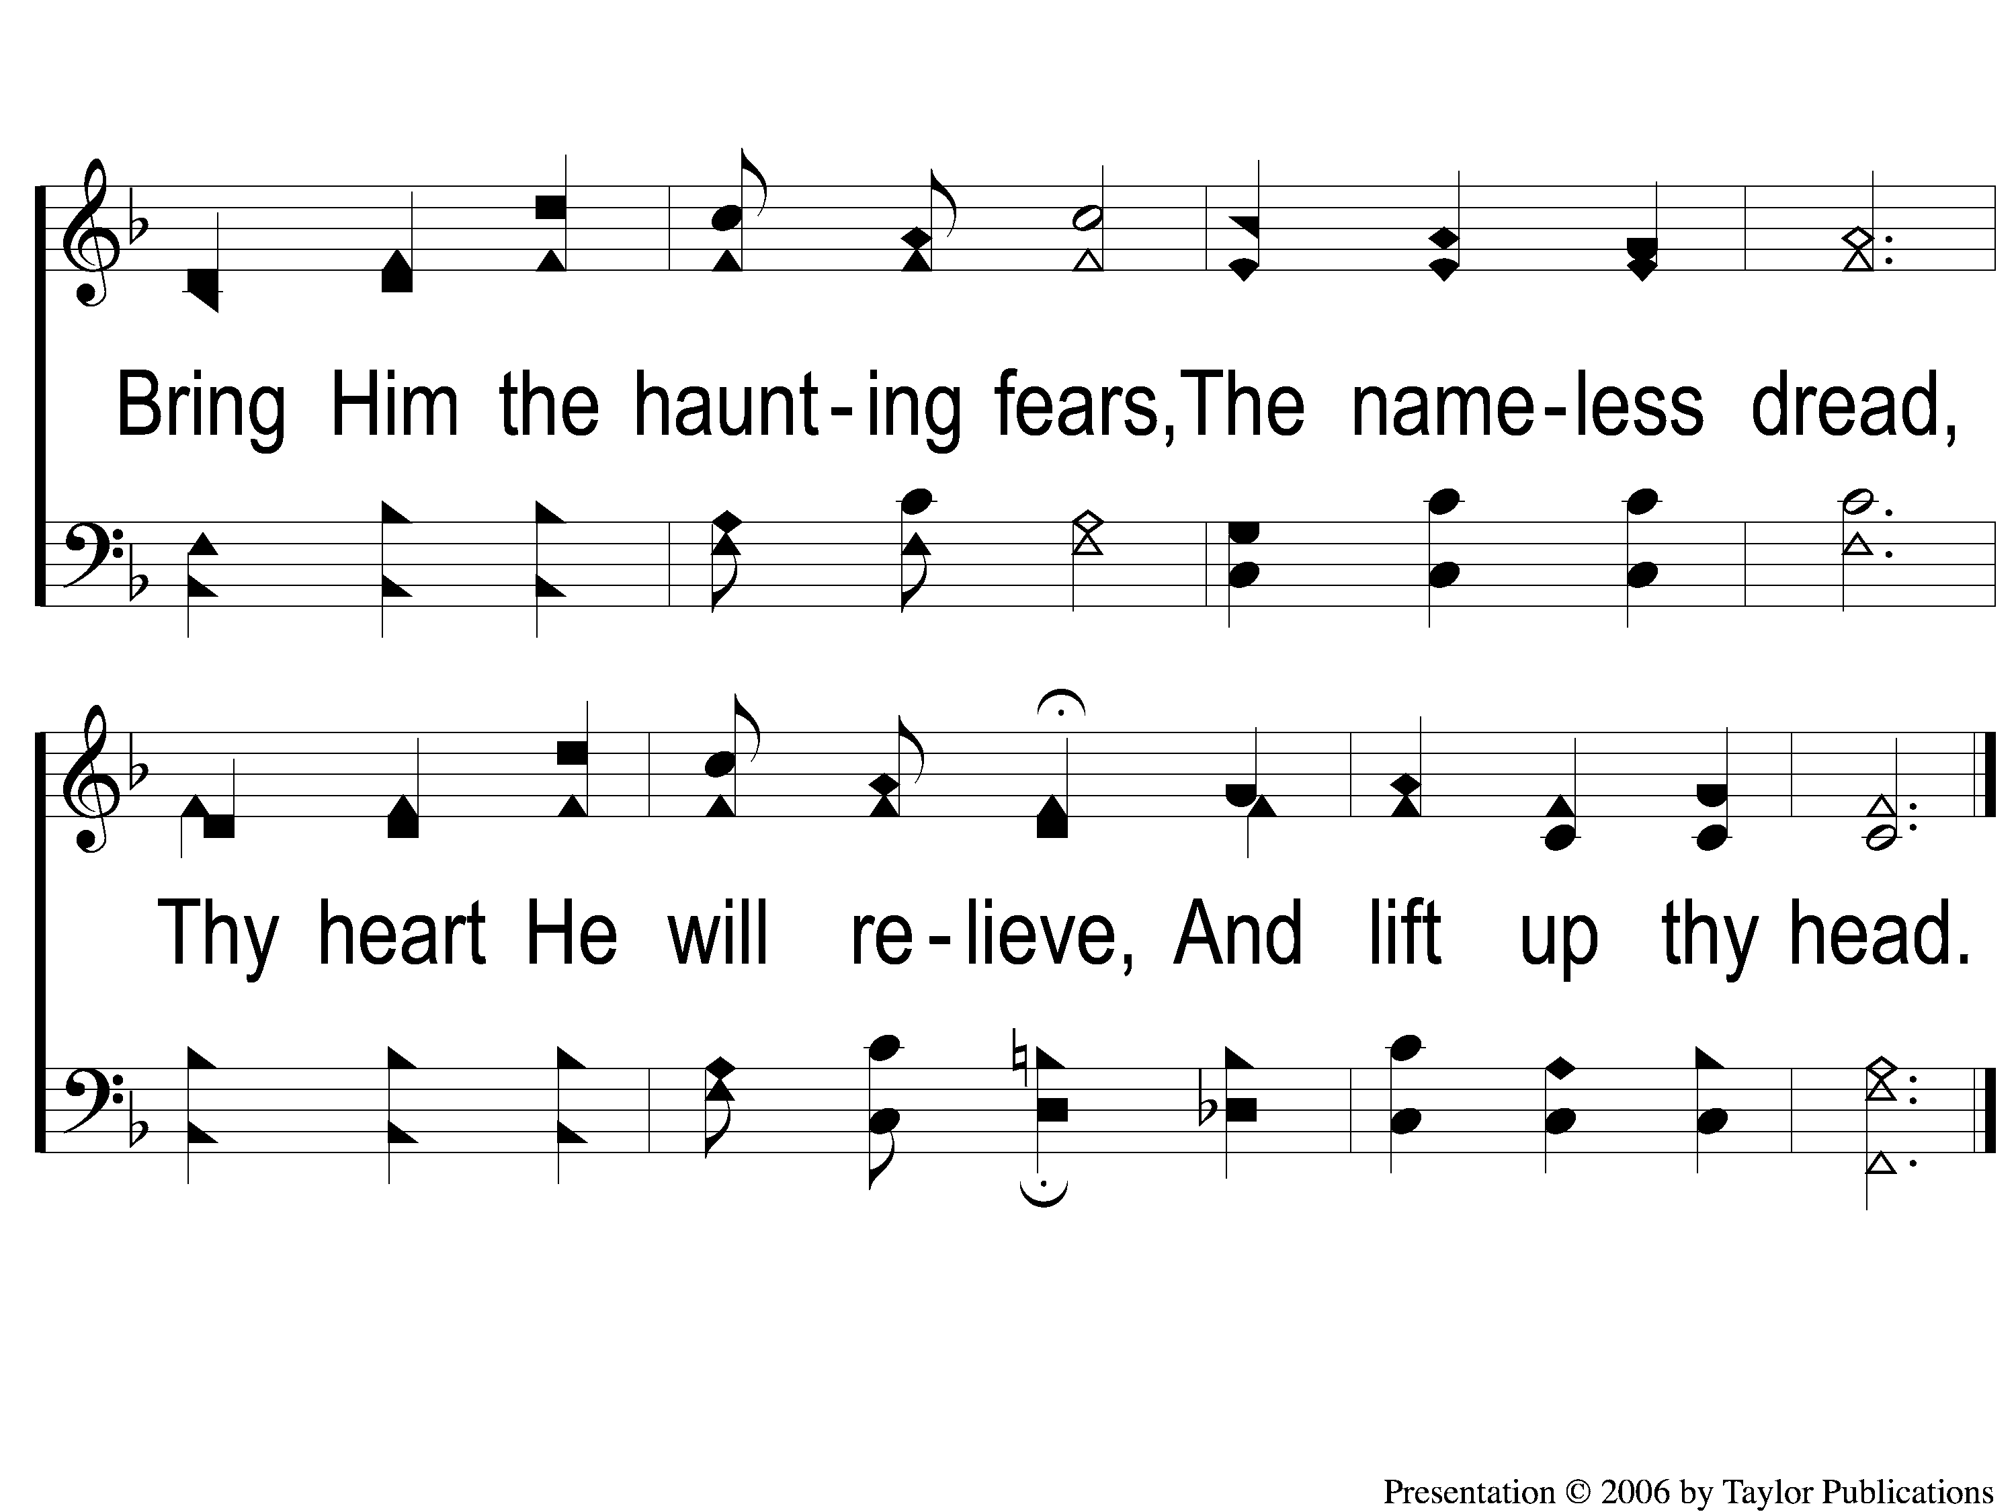
2-2 Bring Christ Your Broken Life
Bring Christ Your Broken Life
62

Slide 5
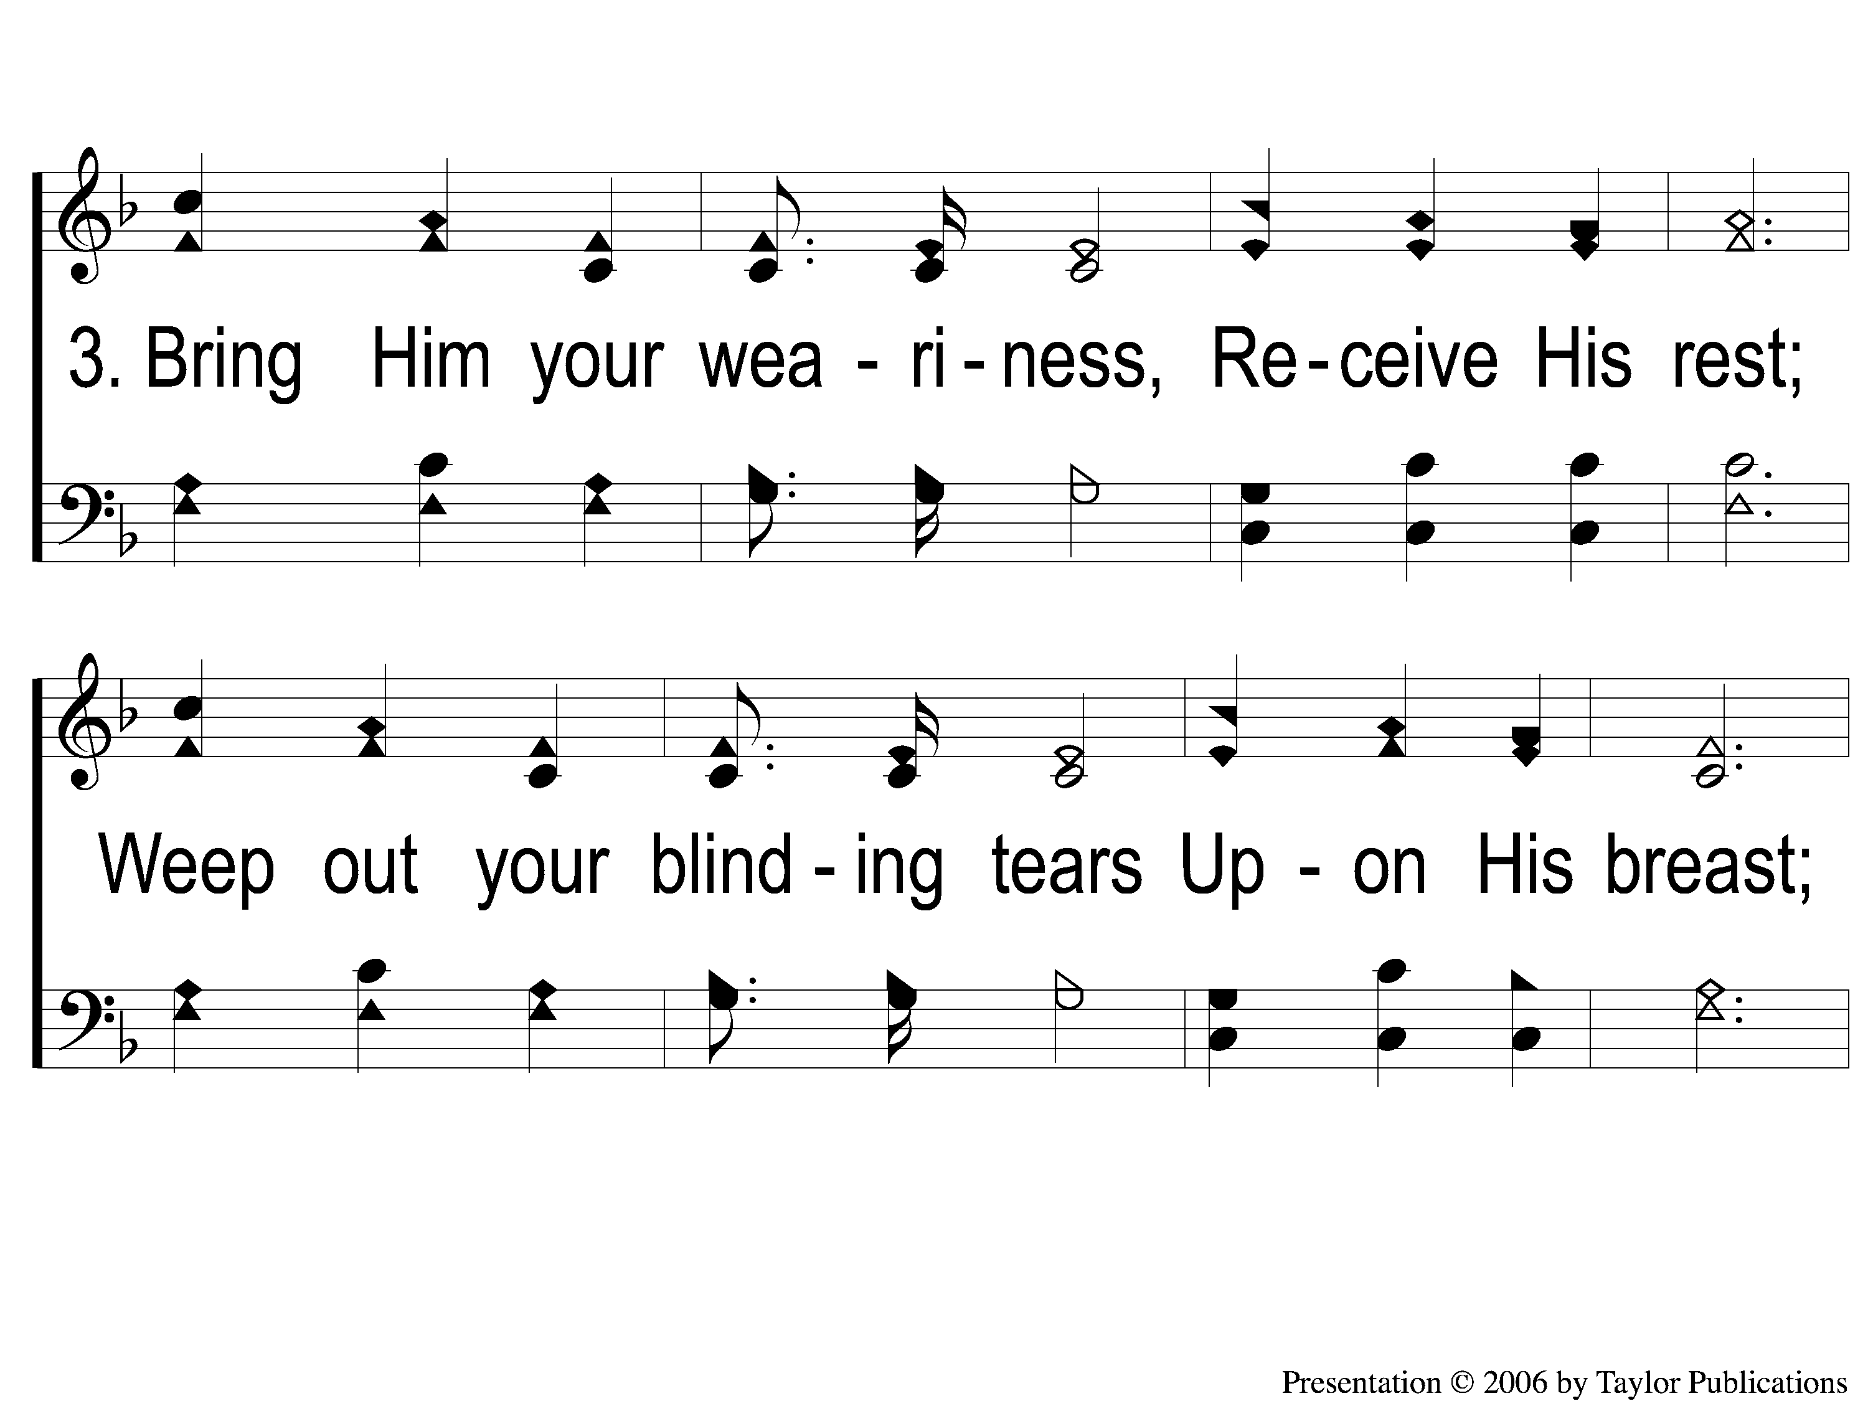
3-1 Bring Christ Your Broken Life
Bring Christ Your Broken Life
62

Slide 6
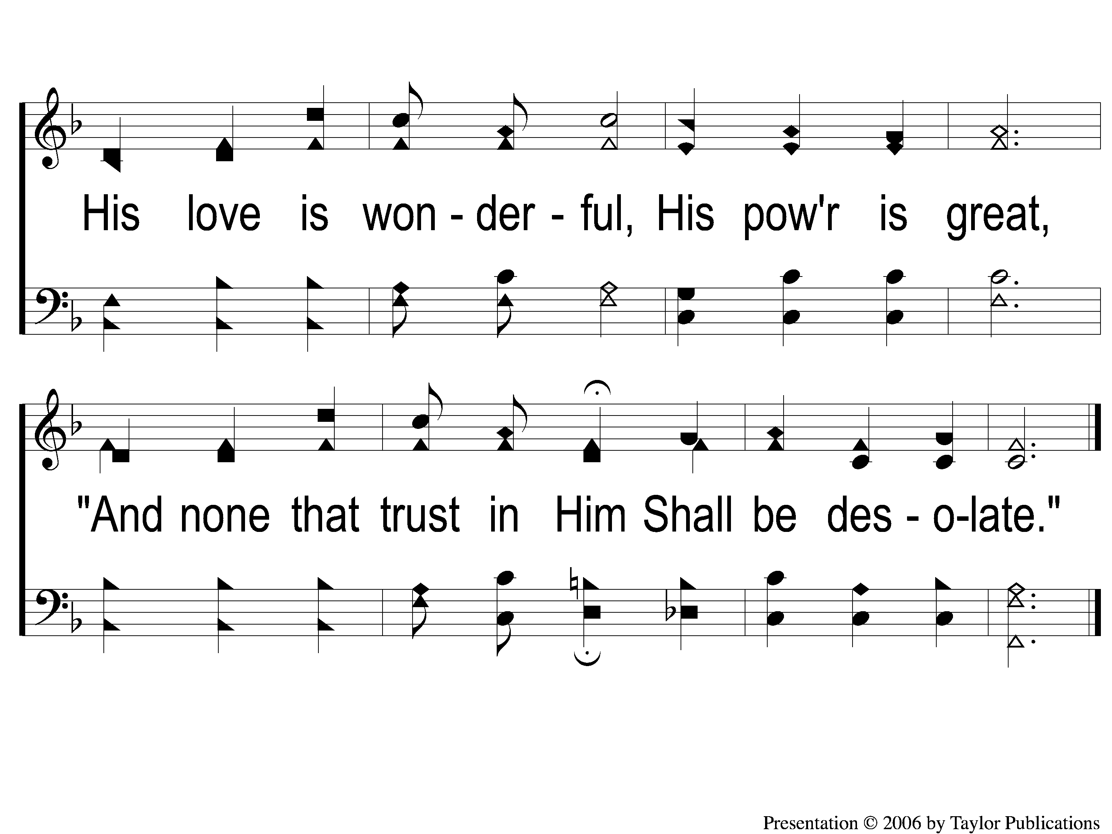
3-2 Bring Christ Your Broken Life
Bring Christ Your Broken Life
62

Slide 7
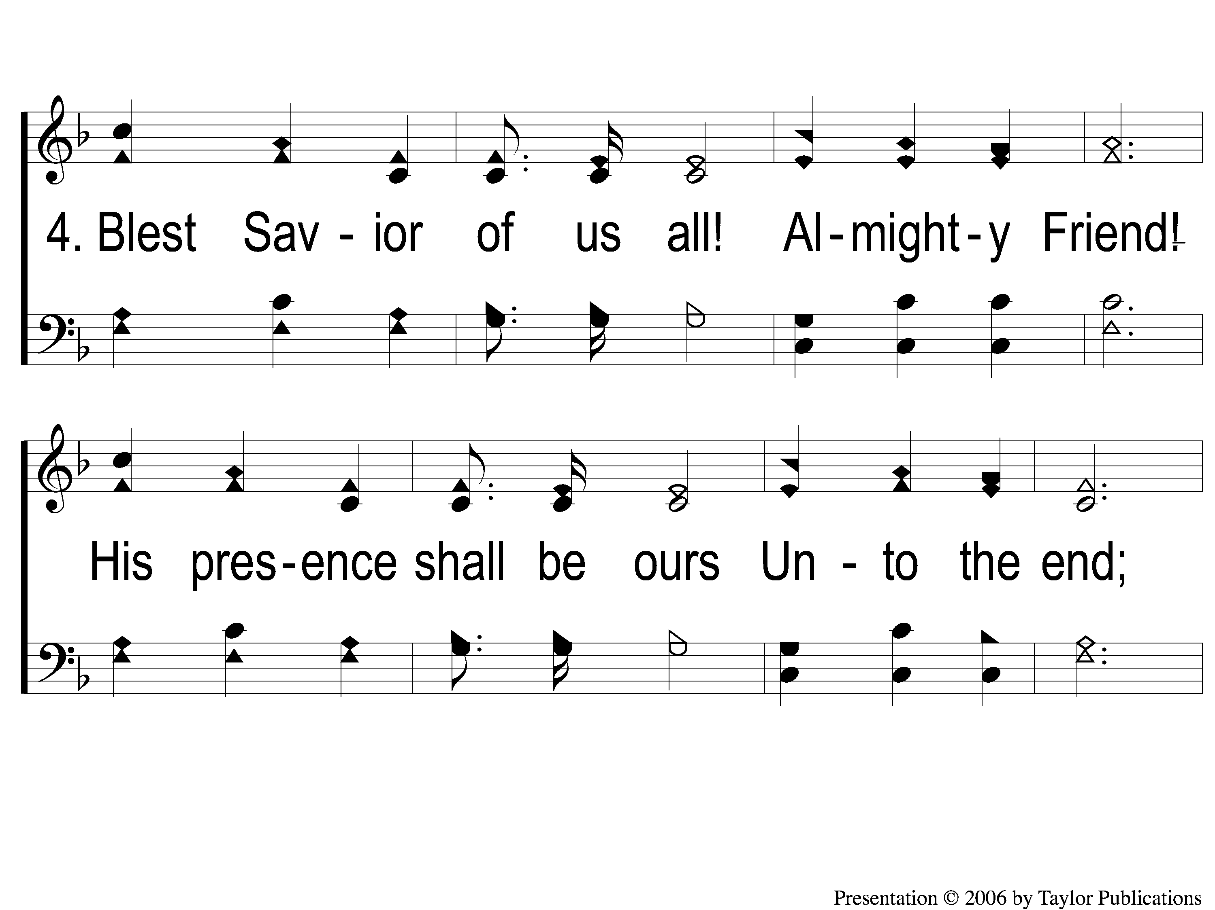
4-1 Bring Christ Your Broken Life
Bring Christ Your Broken Life
62

Slide 8
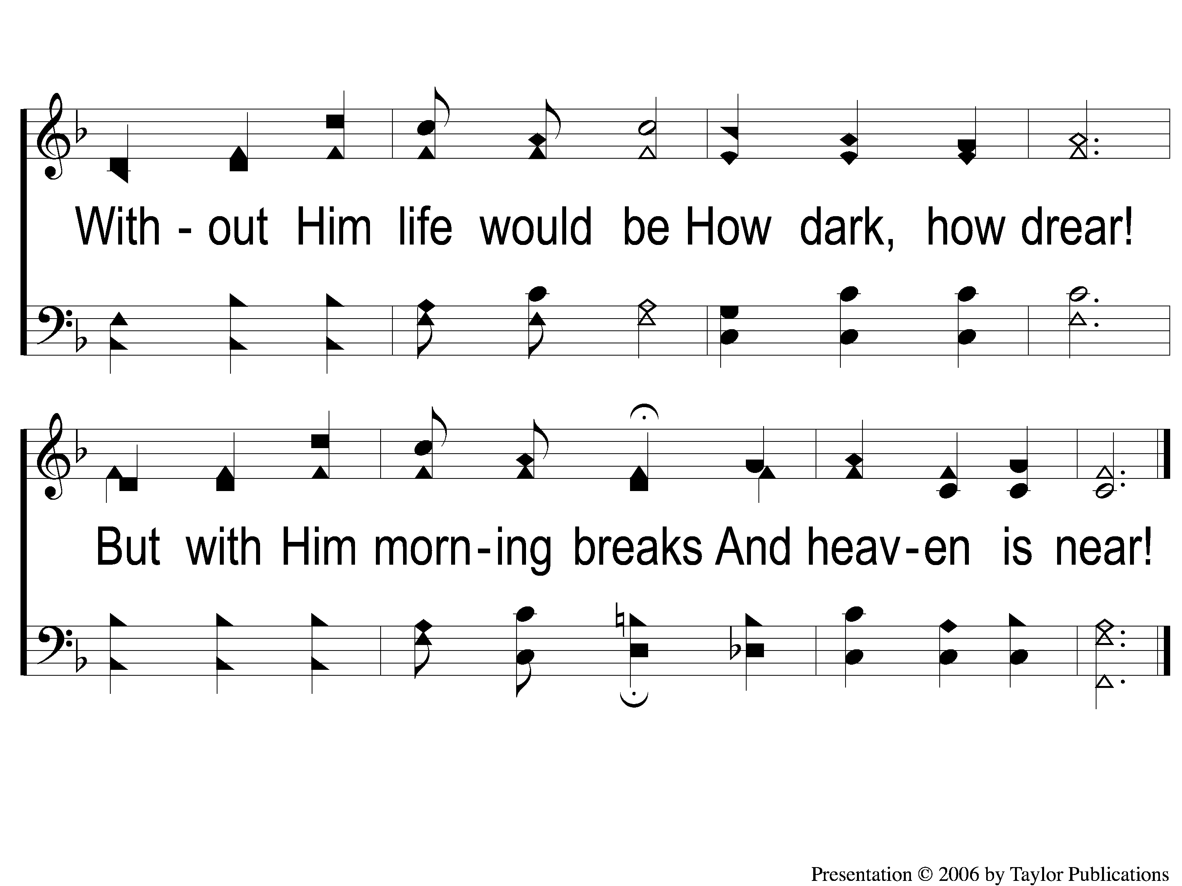
4-2 Bring Christ Your Broken Life
Bring Christ Your Broken Life
62

